Slide 1
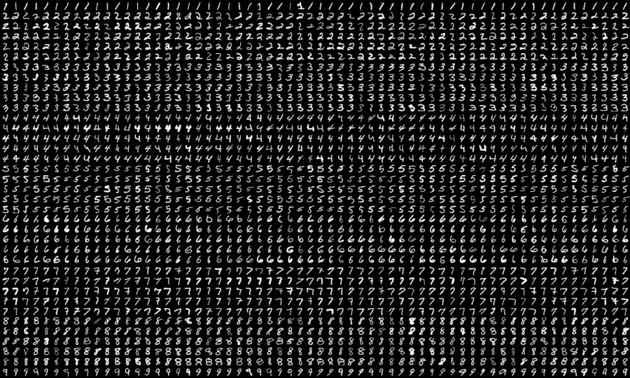
Digit Recognition
Based on MNIST dataset
Supervisors: Karl Rohr, Christian Ritter
Final presentation 2022/07/20
By Lena Fleischhacker, Pia Röhrich, Hellen Röttgen, Benjamin Wehnert
https://neurohive.io/en/datasets/researchers-expanded-the-popular-mnist-dataset-with-50-000-new-images/
Notes:
For our

Slide 2
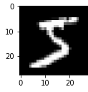
Overview
input:
image
PCA
kNN
output: prediction
it’s a
5!
Notes:
MNIST stands for…
-training 60000 images
-test 10000 images
each row represents…
entry of first col -> label of digit
other cols -> intensity values from 0 -255 for 784 pixels

Slide 3
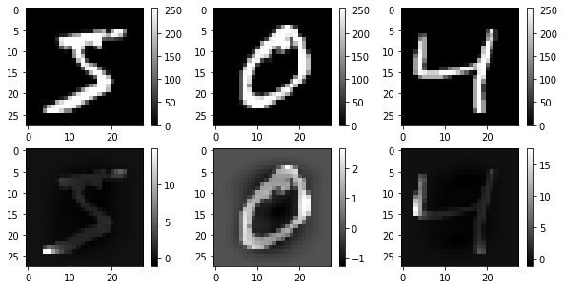


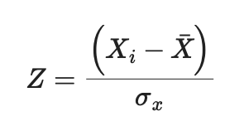
Z-transformation
Notes:
MNIST stands for…
-training 60000 images
-test 10000 images
each row represents…
entry of first col -> label of digit
other cols -> intensity values from 0 -255 for 784 pixels

Slide 4
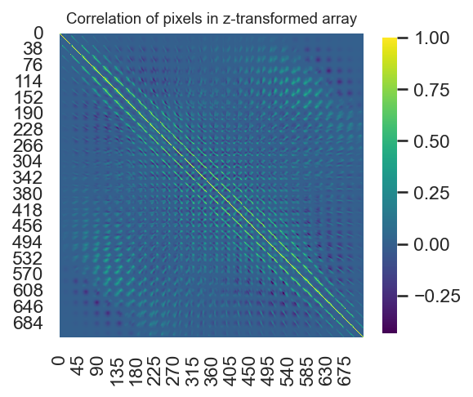
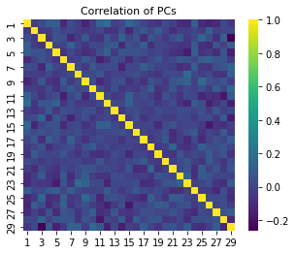
Principal Component Analysis
Notes:
MNIST stands for…
-training 60000 images
-test 10000 images
each row represents…
entry of first col -> label of digit
other cols -> intensity values from 0 -255 for 784 pixels

Slide 5
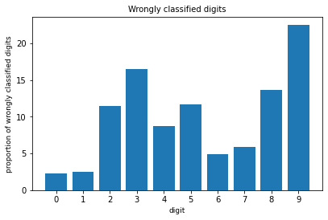
KNN algorithm
97,25 %
Accuracy
9 is most often wrongly classified
Notes:
MNIST stands for…
-training 60000 images
-test 10000 images
each row represents…
entry of first col -> label of digit
other cols -> intensity values from 0 -255 for 784 pixels

Slide 6
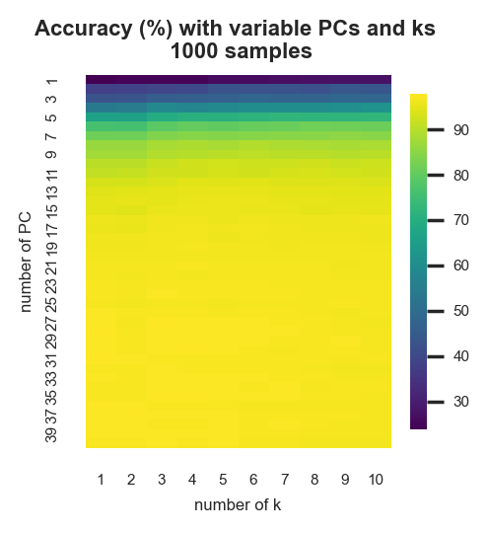
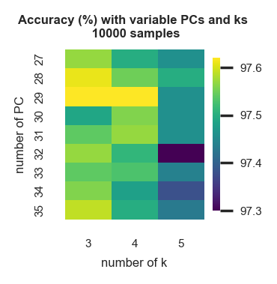
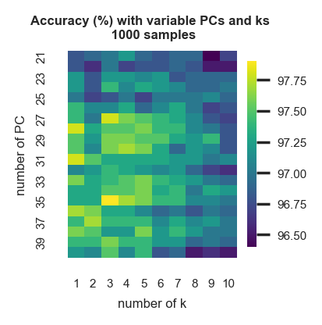
finding k and PCs
Notes:
MNIST stands for…
-training 60000 images
-test 10000 images
each row represents…
entry of first col -> label of digit
other cols -> intensity values from 0 -255 for 784 pixels

Slide 7
Expansion of the project
I
Average images
II
PCA with singular value decomposition
III
Self-written digit recognition
Notes:
MNIST stands for…
-training 60000 images
-test 10000 images
each row represents…
entry of first col -> label of digit
other cols -> intensity values from 0 -255 for 784 pixels

Slide 8
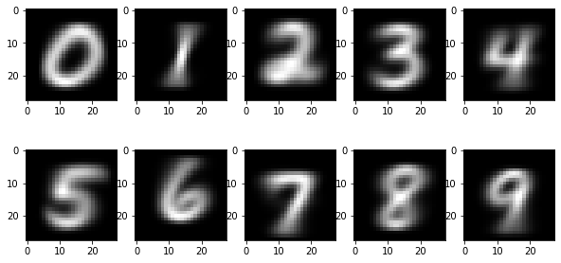
Average images
I
normal digit recognition:
66,85%
weighted digit recognition:
72,07%
Notes:
MNIST stands for…
-training 60000 images
-test 10000 images
each row represents…
entry of first col -> label of digit
other cols -> intensity values from 0 -255 for 784 pixels

Slide 9


PCA with SVD
II
Principal components:
Notes:
MNIST stands for…
-training 60000 images
-test 10000 images
each row represents…
entry of first col -> label of digit
other cols -> intensity values from 0 -255 for 784 pixels

Slide 10
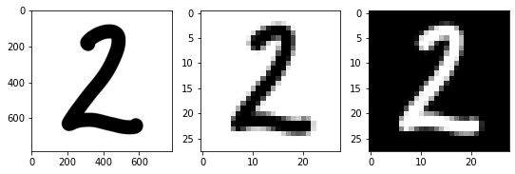
Self-written digit recognition
III
Preprocessing of the input images:
Now it’s your turn!
Notes:
MNIST stands for…
-training 60000 images
-test 10000 images
each row represents…
entry of first col -> label of digit
other cols -> intensity values from 0 -255 for 784 pixels

Slide 11



Discussion
succsessful application of PCA and kNN
high accuracy
algorithm can classify some self-written images
average images as additional method
high runtime
no learning algorithm
expand algorithm to hand-written digits from photos
recognition of multi-figure numbers
Notes:
MNIST stands for…
-training 60000 images
-test 10000 images
each row represents…
entry of first col -> label of digit
other cols -> intensity values from 0 -255 for 784 pixels

